Slide 1
Managing Kanban with Jira
Understanding Jira Issues, Agile Boards and Charts
Victor Grazi
Mitch Cox

Slide 2
Todo
Bulk update
Structure
Notes:
Victor

Slide 3
Kanban Mantras
Make work visible
Limit Work in Progress
Measure and Manage Work
Prioritize effectively
Adjust based on feedback and metrics

Slide 4
Time Thieves
Too much Work in Progress
Unknown Dependencies
Unplanned Work
Conflicting Priorities
Neglected Work

Slide 5
Day to Day
Always use a fix version for traceability
Keep your Jiras flowing
Have daily standups to identify blockers, assign priorities, and move Jiras
Press the Jira “release” button when a release is done.
Clears everything from the Done column
Generates release summary report

Slide 6
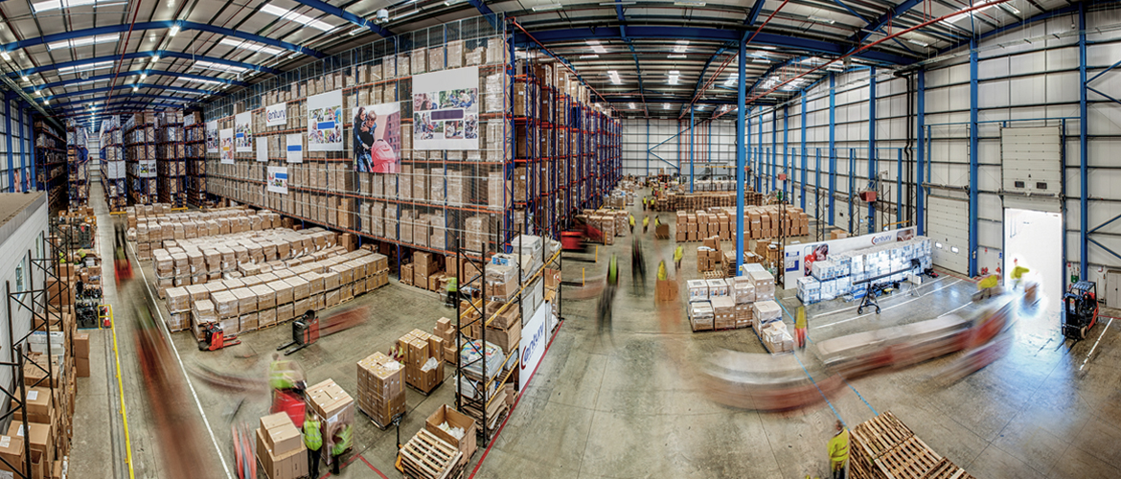
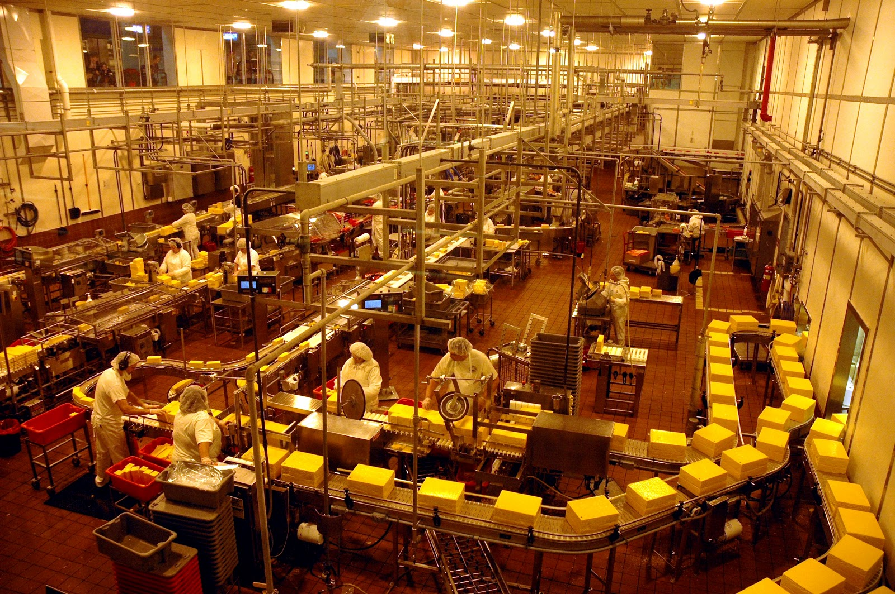
In a traditional factory it was easy to visualize the flow of work…
Traditional Flow Visualization
5/

Slide 7


But in a software shop, every desk looks the same.
Knowledge Workers Look Alike!

Slide 8
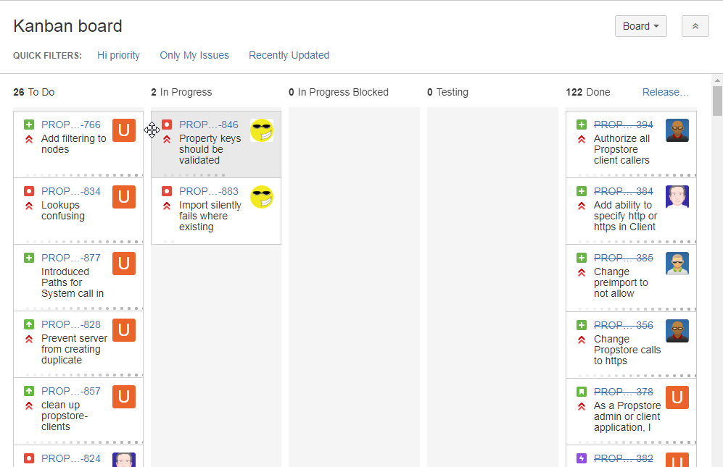
Icons show user
Dots show days in the column
Lead Time to Delivery
Cycle Time to Deployment

Slide 9
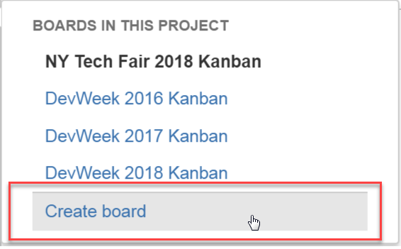
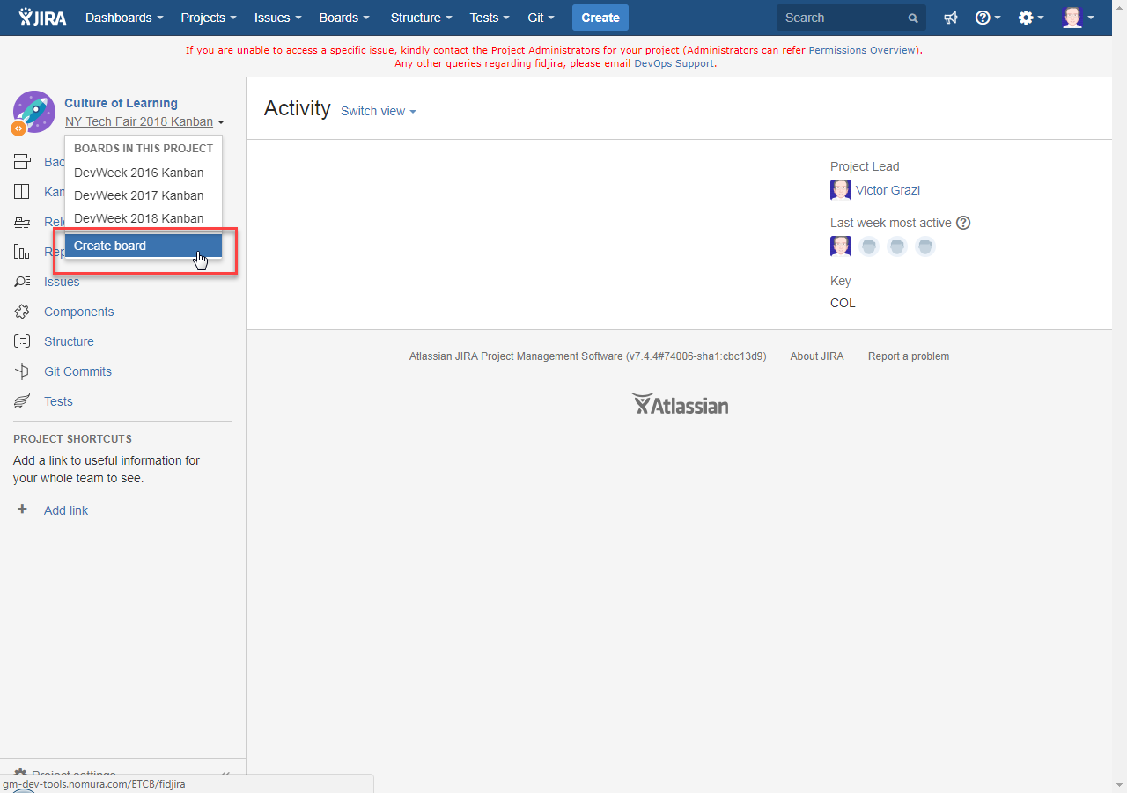
Create a new board

Slide 10
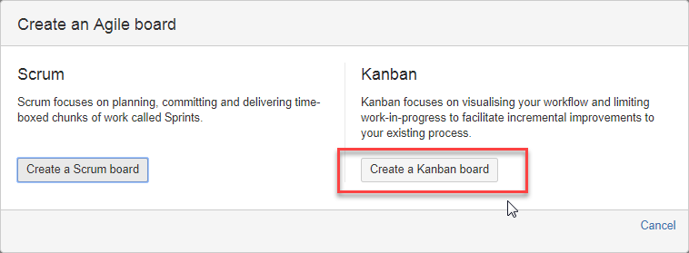
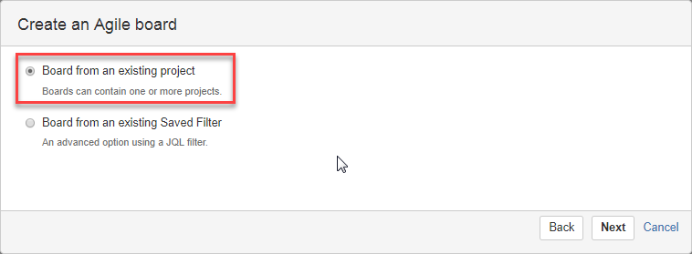
Kanban board or Scrum board (or both!)

Slide 11
Difference between Scrum Board and Kanban Board
Kanban
Exceed work in progress turns red
Wip limits
Days in column
No sprints
Scrum
Sprints
Backlogs

Slide 12
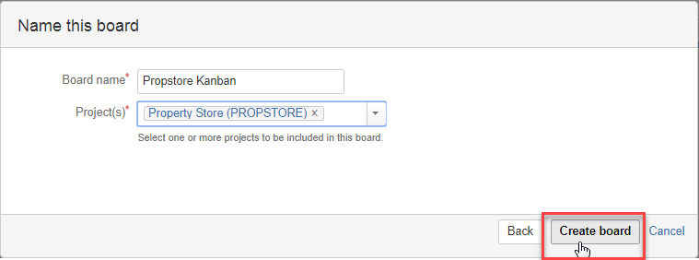
Kanban board or Scrum board (or both!)

Slide 13
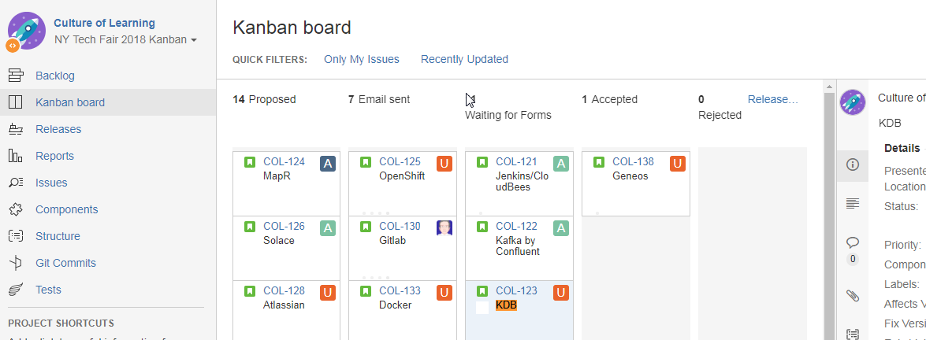
Backlog

Slide 14
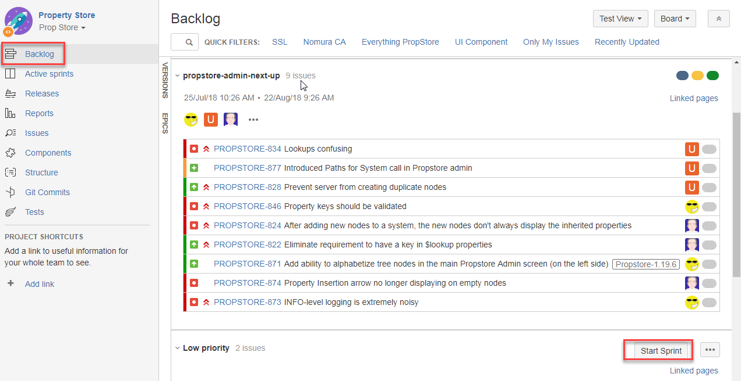
Backlog

Slide 15
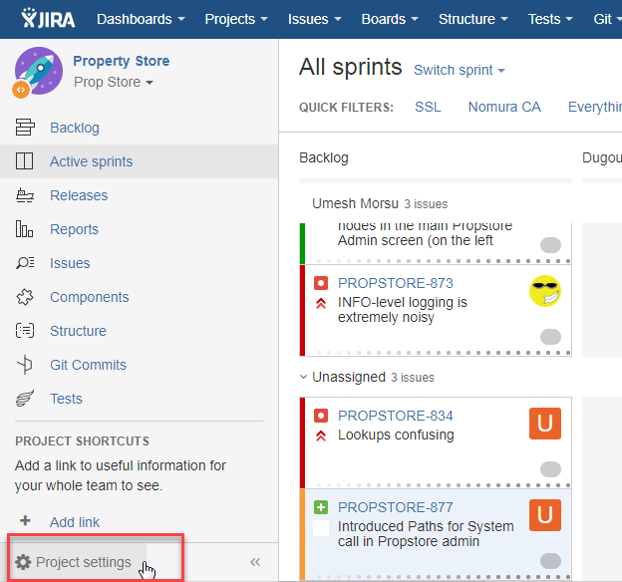
Project settings

Slide 16
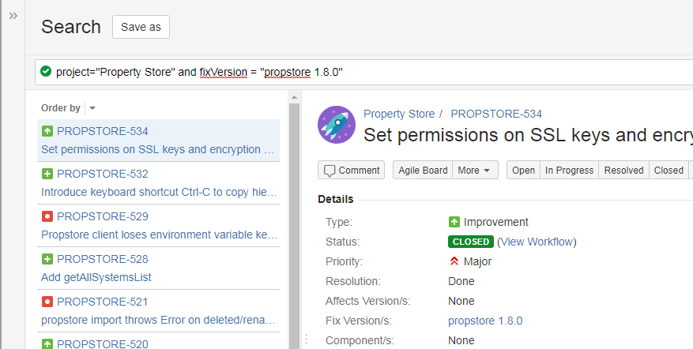
Filtering

Slide 17
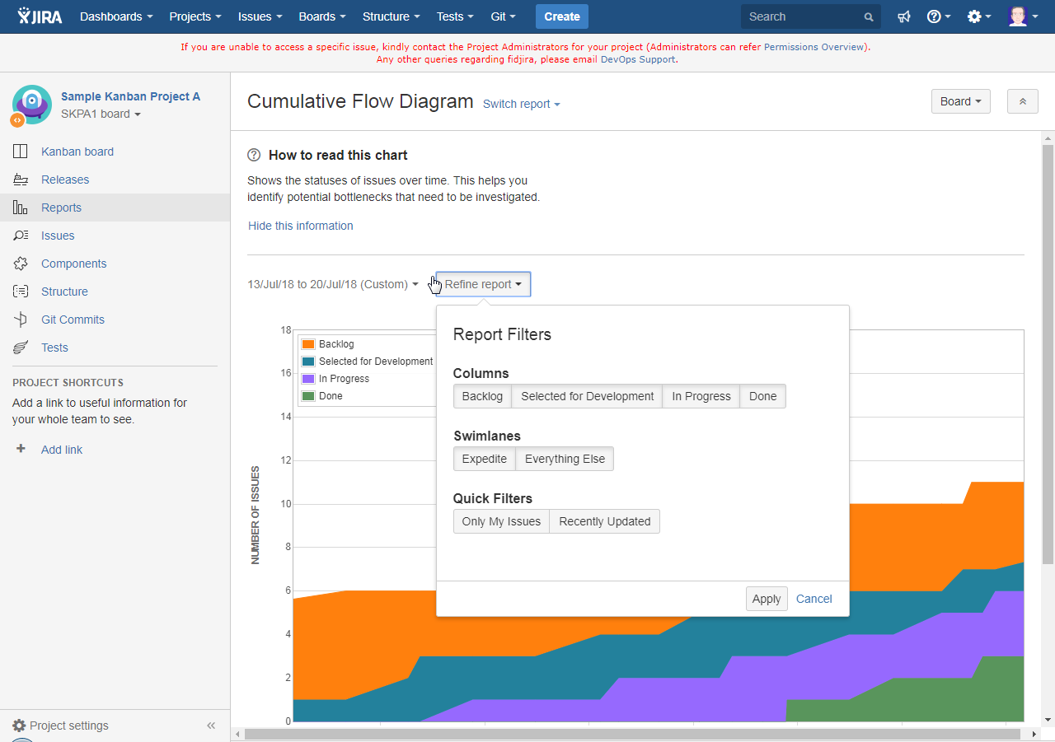
Notes:
Victor

Slide 18
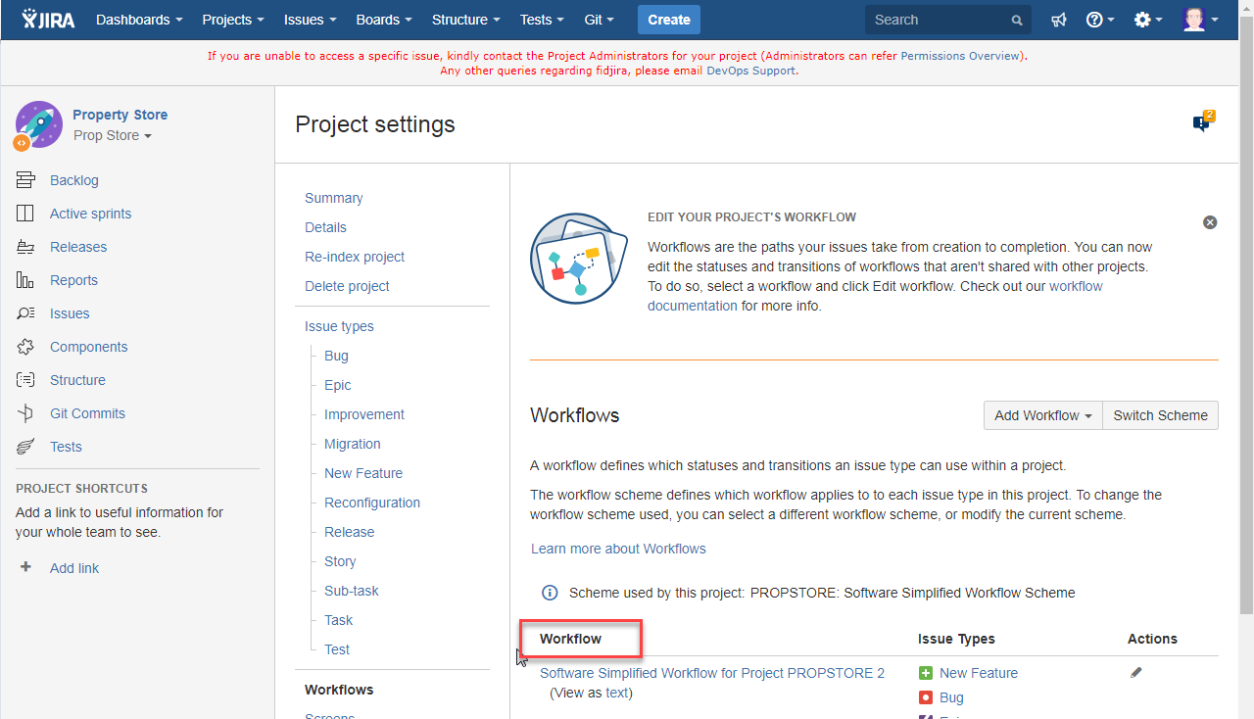
A workflow defines statuses, transitions, and resolutions, that describe the workflow of your Jiras
Notes:
Mitch

Slide 19
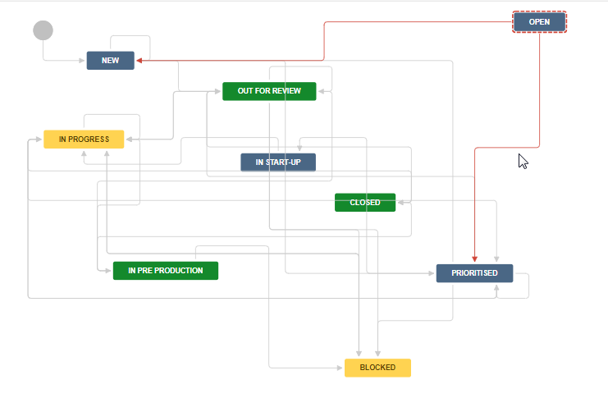
A workflow defines statuses, transitions, and resolutions, that describe the workflow of your Jiras
Notes:
Mitch

Slide 20

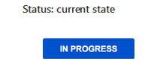
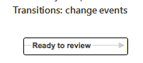
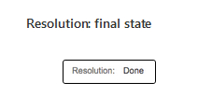
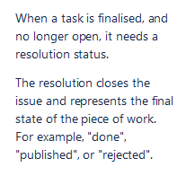
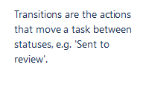
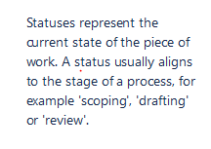
Notes:
Mitch

Slide 21

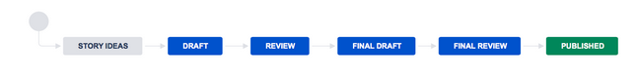
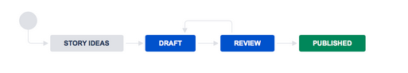
Story Ideas
Draft
Published

Slide 22

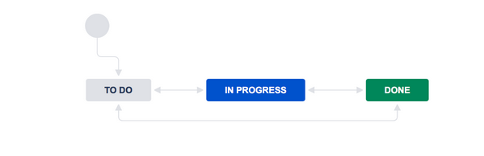
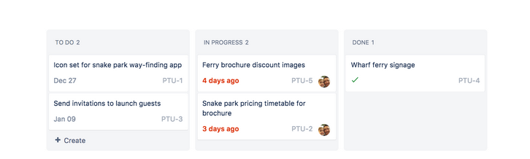
Notes:
Mitch

Slide 23
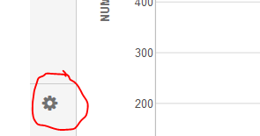
How can you tell your permissioned?
Notes:
Mitch

Slide 24
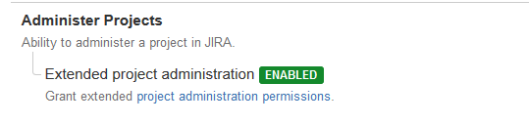
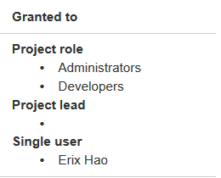
Permissions and Users and Roles (To Modify Workflow)
1. Must have the Administer Projects Permission granted to the Role
2. By Default this is granted to Administrators role
Notes:
Mitch Only people with project Administer Projects permission for your project can modify a worflow
To obtain this permission, email the project administrator

Slide 25
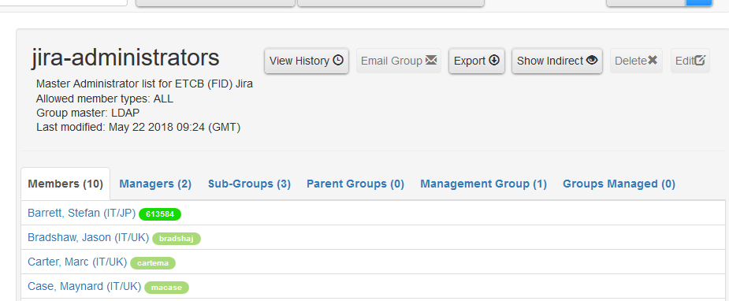
Permissions and Users and Roles (Create new or add additional workflows)
Or you can email DevOps Support <devops-core-prodservices-fidl@nomura.com>
Notes:
Mitch

Slide 26
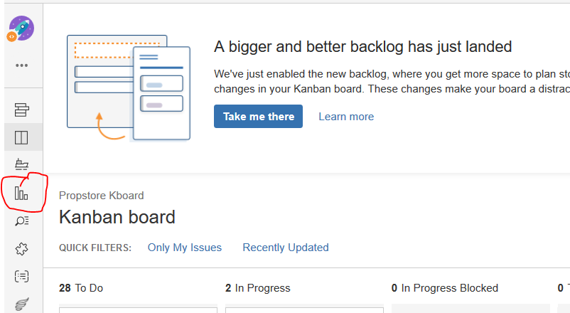
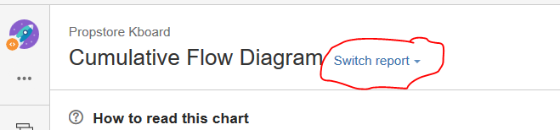
Reports:
Notes:
Victor

Slide 27
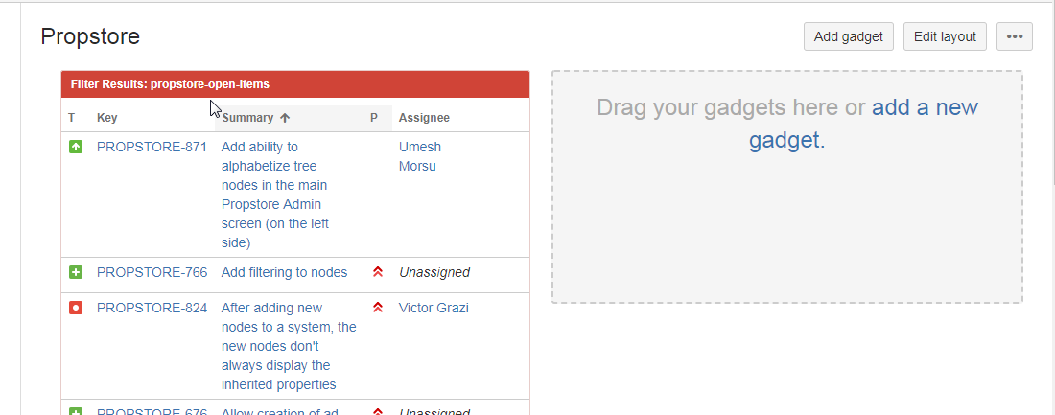
Dashboard

